Slide 1
Occupational Specialist Component Content: Digital Production, Design and Development
The T Level T Level Technical Qualification in Digital: Digital Production, Design and Development includes a single Occupational Specialist Component. Therefore, there is a single synoptic assessment for the Occupational Specialist Component, which is an extended ‘design, development and implementation’ project. The synoptic element of the project is important in order to ensure that students are able to demonstrate threshold competence: this is the principal reason why the Occupational Specialism is assessed via a single extended project assessment to ensure that students are able to evidence all the skills required by the Performance Outcomes.
The T Level Technical Qualification in Digital: Digital Production, Design and Development Occupational Specialist Component consists of several activities grouped into four substantive tasks.
Each task will be completed during a window set by Pearson during which you will schedule supervised assessment sessions. In some cases, tasks will also involve opportunities for unsupervised activities where the requirements of the skills being assessed make this necessary.

Slide 2
Learning Objectives
Aims:
To understand research an exploration
Objectives:
To be able to explore an initial client brief with specific references to:
Context & Market Environment
Common Problems and Risks
Current Hardware and Software Usage
Emerging Technologies
Existing and Potential Solutions
Guidelines and Regulations
Skills & Knowledge Gaps
Learning & Development Plan

Slide 3
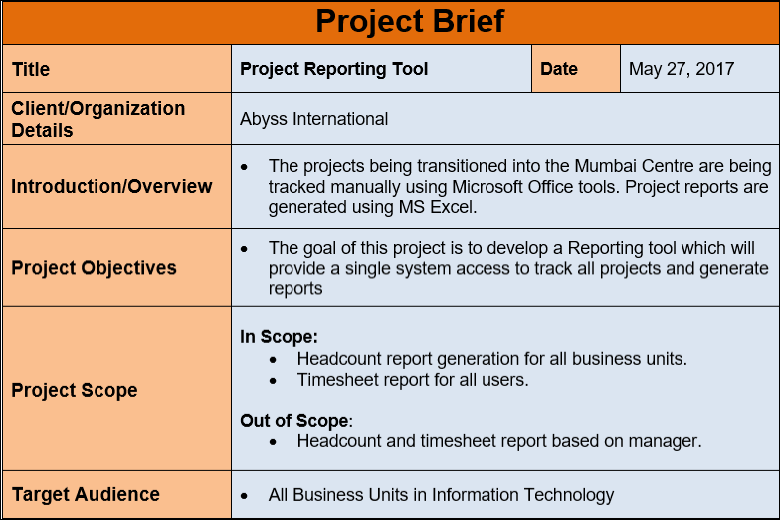
Exploring the Initial Client Brief
The client brief provides direction and scope for the entire project.
Intent: To break down and understand what the client is asking for.
Clarify project goals and vision
Understand end-user needs and pain points
Identify project constraints: time, budget, deliverables
Highlight client expectations and success criteria

Slide 4
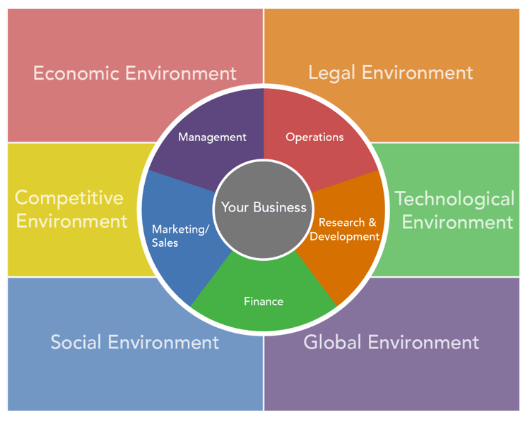
Context & Market Environment
Research into the project’s industry helps position it appropriately.
Intent: Explore the environment in which the solution will exist.
Overview of industry trends
Key audience demographics and behaviour
Direct and indirect competitors
Influencing economic or social factors

Slide 5
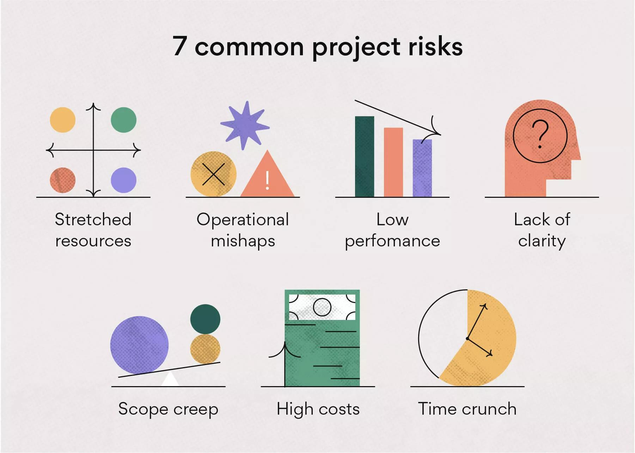
Common Problems and Risks
Identifying potential obstacles prepares the project for mitigation strategies.
Intent: Highlight challenges that may impact development and outcomes.
Technical limitations or compatibility issues
Budget and resource constraints
Security and privacy vulnerabilities
Stakeholder disagreements or shifting requirements

Slide 6
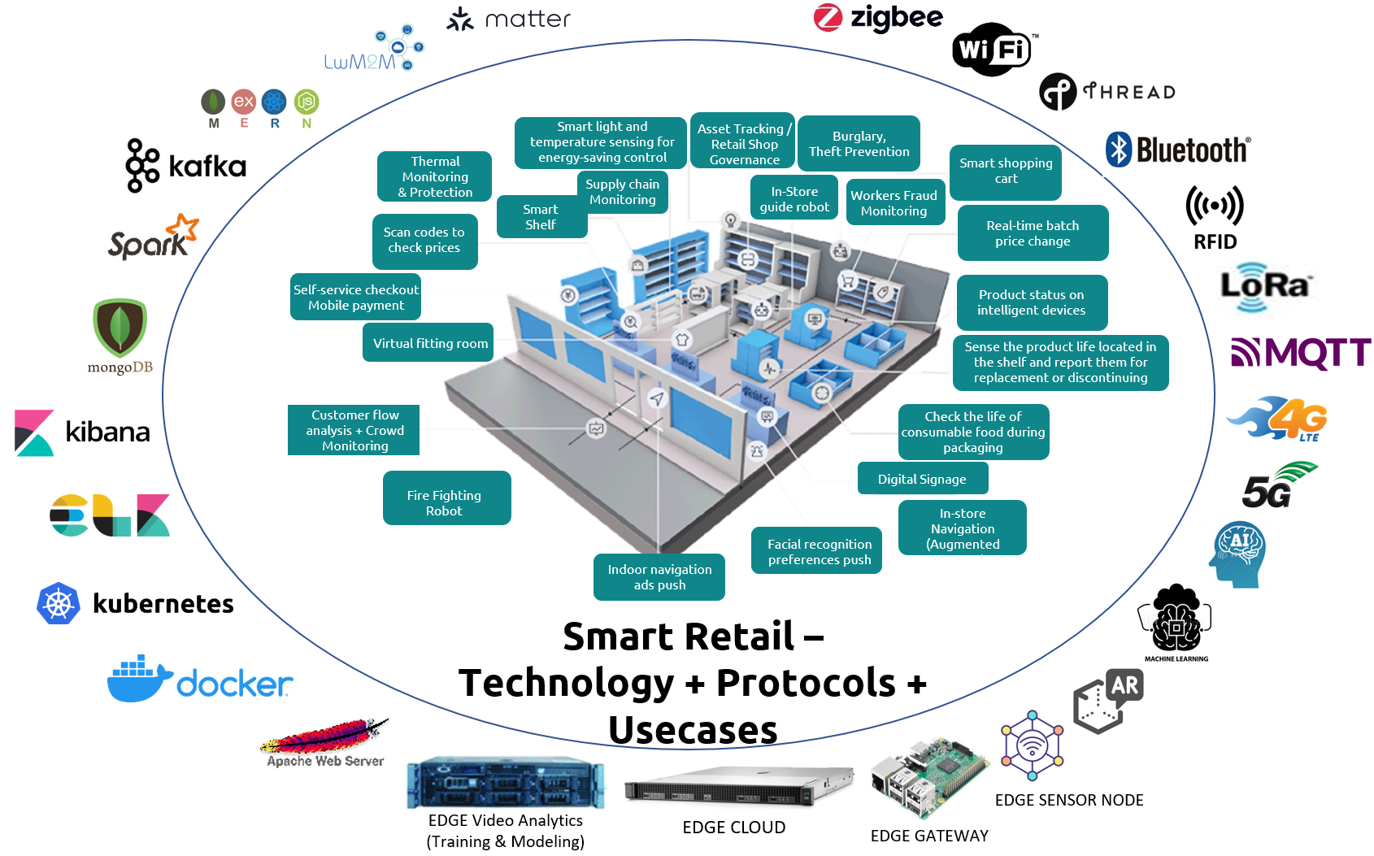
Current Hardware and Software Usage
Understanding tools commonly in use offers a benchmark for innovation.
Intent: Map out what’s currently being used within the target environment.
Popular hardware setups (e.g., mobile, desktop, sensors)
Widely adopted software and platforms
Integration with legacy systems
User familiarity with existing tools

Slide 7

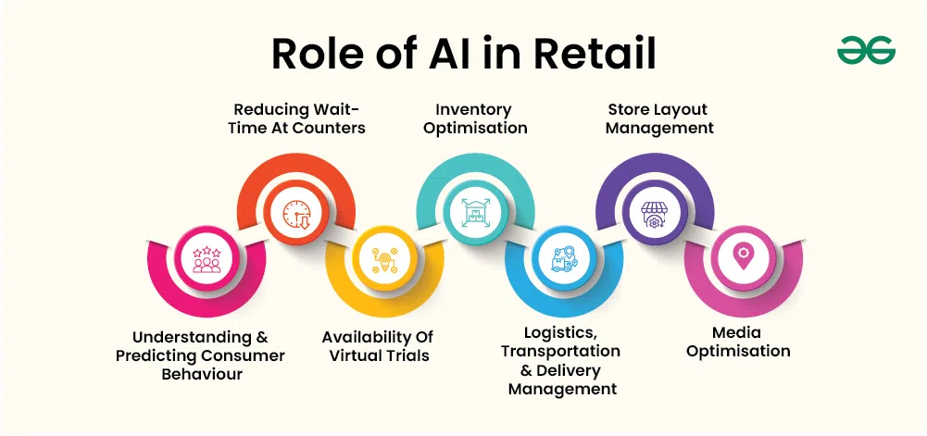

Emerging Technologies
Innovations offer new possibilities for solving problems more effectively.
Intent: Explore cutting-edge tools that could enhance the project.
AI/ML, AR/VR, and automation trends
Low-code/no-code platforms
Edge computing and IoT
Relevance to current and future user needs

Slide 8
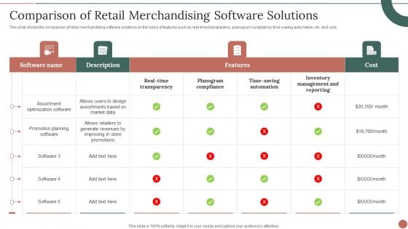
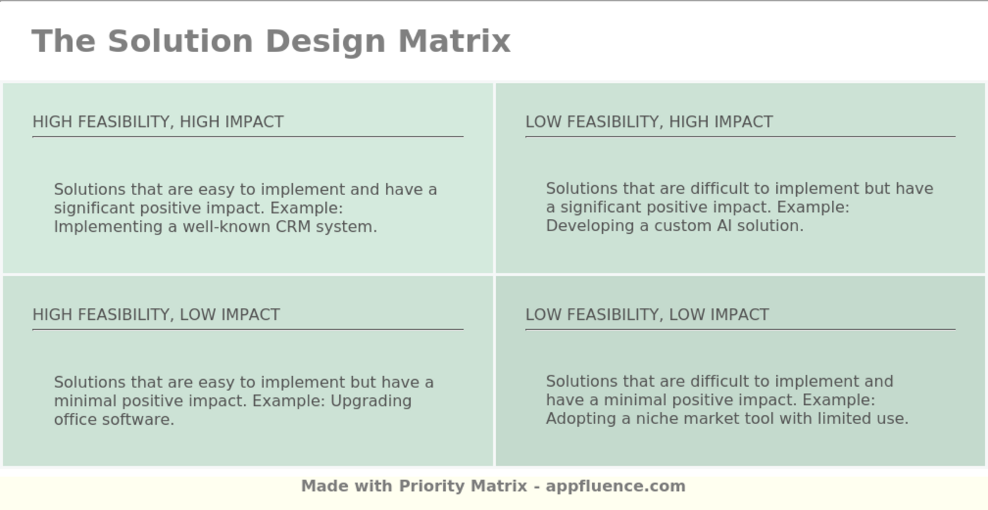
Existing and Potential Solutions
Evaluating current solutions reveals opportunities for improvement or differentiation.
Intent: Review what's already out there and how it meets or fails user needs.
Case studies from similar projects
Competitor feature analysis
What users like/dislike about existing solutions
Gaps and opportunities for innovation

Slide 9
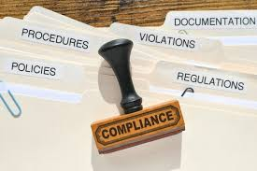
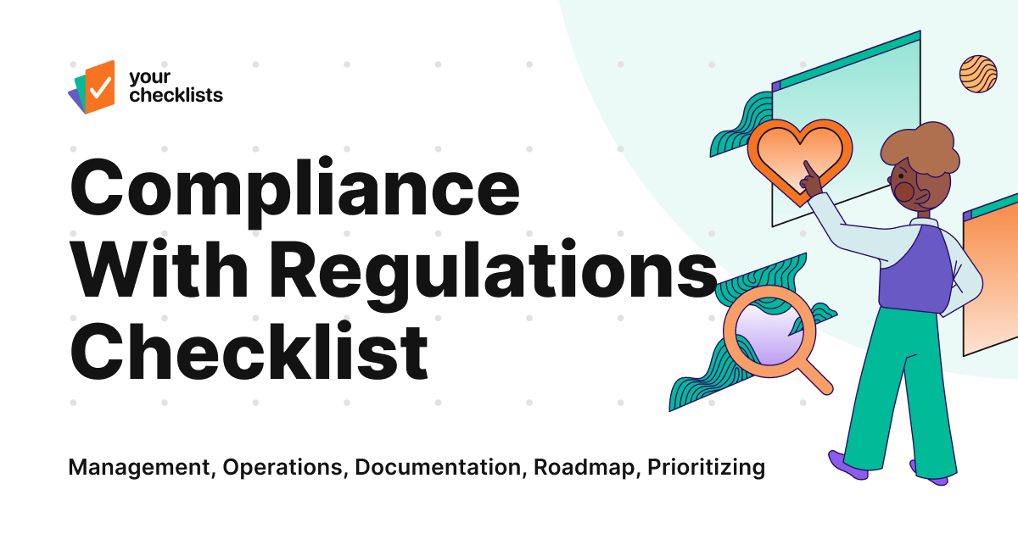
Guidelines and Regulations
Projects must comply with standards and ethical considerations.
Intent: Ensure legal and regulatory alignment to avoid risk.
Data protection (e.g., GDPR, HIPAA)
Accessibility standards (e.g., WCAG 2.1)
Industry-specific requirements (e.g., safety, financial reporting)
Ethical design considerations

Slide 10
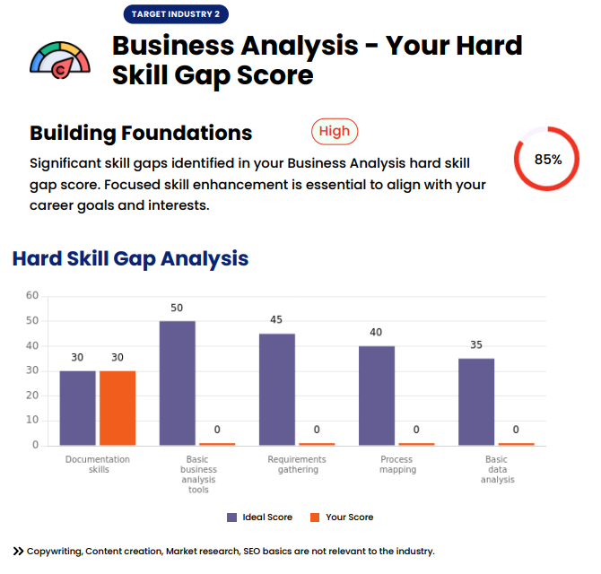

Skills & Knowledge Gaps
Self-assessment ensures you’re ready to meet project demands.
Intent: Identify areas for professional growth and development.
Evaluate current technical and soft skills
Identify gaps relevant to project needs
Get feedback from mentors or peers
Prioritize areas needing immediate improvement

Slide 11
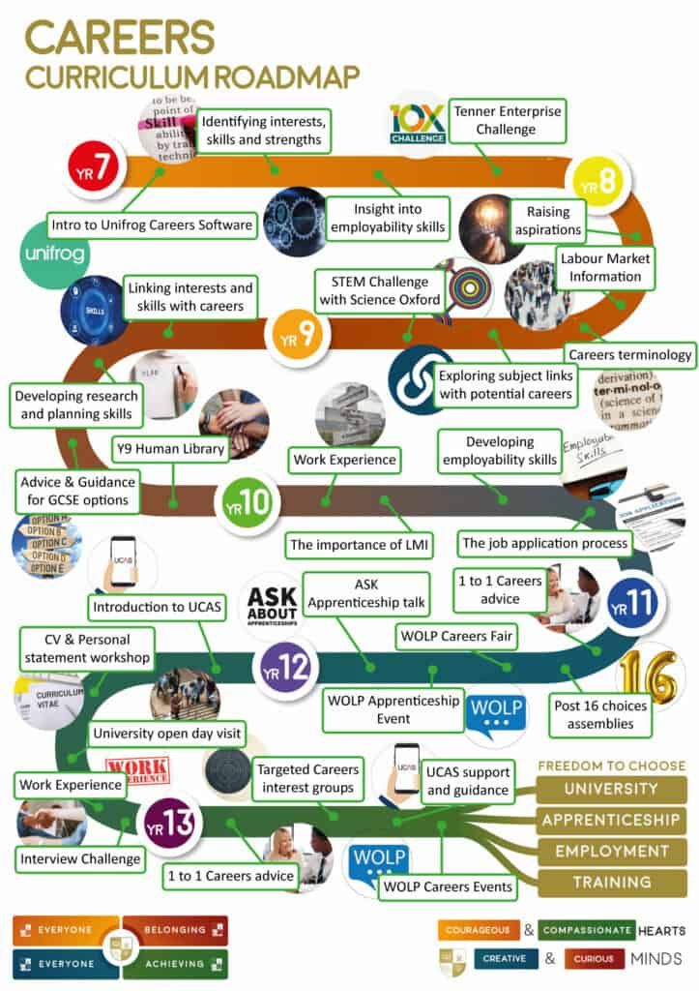

Learning & Development Plan
A clear plan ensures progress toward overcoming knowledge gaps.
Intent: Lay out how to acquire missing skills for successful project delivery.
Online courses, tutorials, or certifications
Team shadowing or mentorships
Set learning goals with deadlines
Regular progress tracking and reflection
Notes:
8 Rules For Learning to Code in 2025...and should you?
https://www.youtube.com/watch?v=EMWNZtCYg5s

Slide 12

Activity – “Pitch & Plan" Challenge
Apply your research skills in a fast-paced team challenge to solve a real-world client brief. (Project_Brief_Handout_BalancePlus.docx)
Intent: To consolidate knowledge through collaboration, critical thinking, and creative problem-solving.
What You’ll Do:
Work in teams of 3 roles: 🔹 Research Lead 🔹 Risk & Compliance Analyst 🔹 Skills Strategist
What You’ll Gain:
Real-world problem analysis
Industry-aligned thinking
Practice in teamwork and communication
Reflection on your own learning needs
Notes:
Time: 45–60 mins
Pitch to the class
Feedback after each team

